Slide 2
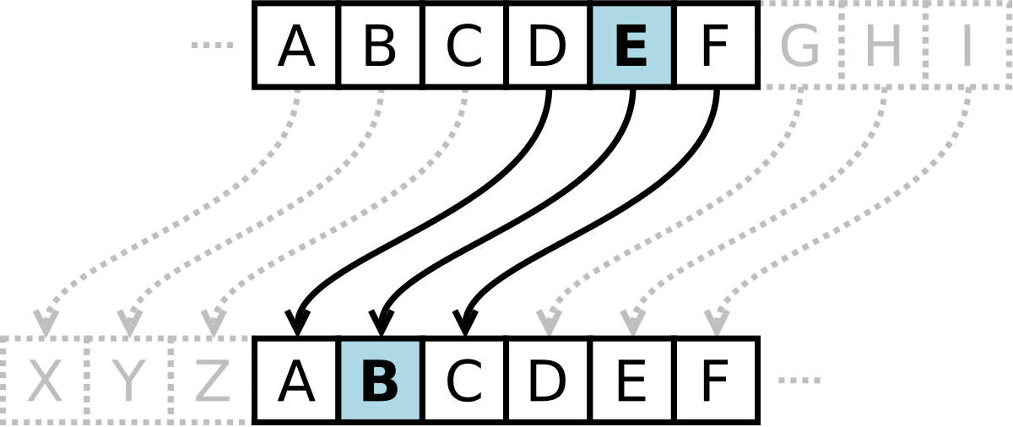
Cryptography Concepts
The science of keeping information secret
Notes:
Ciphertext = transforming data into gibberish

Slide 3


Cryptography Concepts
Two peers can establish a secret communication
Let’s talks
Secret/Private/Secure
Notes:
Ciphertext = transforming data into gibberish

Slide 4




Cryptography Concepts
Authorized users
Communications
Data
Notes:
Ciphertext = transforming data into gibberish

Slide 5
Cryptography and Security Concepts
Confidentiality
Encryption
Integrity
Hashing
Availability
Redundancy
Fault-tolerance
Notes:
Ciphertext = transforming data into gibberish

Slide 6
Cryptography and Security Concepts
Non-repudiation
Digital signature
Notes:
Ciphertext = transforming data into gibberish

Slide 7
Lightweight Cryptography
Used for lower power devices
Constrained devices
Ciphers
PRESENT
TWINE
Notes:
Ciphertext = transforming data into gibberish

Slide 8


Quantum
Communications and Computing
Currently theoretical
Encryption concerns
Post –quantum
Resilient to quantum computing
Notes:
Ciphertext = transforming data into gibberish

Slide 9

Blockchain
Distributed
Decentralized
Public ledger (record keeping)

Slide 10



Blockchain
Transaction information stored in blocks
Can be publicly verified
Hash applied
Notes:
A blockchain is a digital record of transactions. The data once entered into the block the block cannot be modified making the transaction a publicly verifiable.
The transaction is verified by a network of peer-to-peer computers that verify the transaction and the block is added (and timestamped) as the next transaction in a group called a chain

Slide 11
Blockchain
Each block is added to create a chain
Every transaction can be verified
Notes:
the name comes from its structure, in which individual records, called blocks, are linked together in single list, called a chain. Blockchains are used for recording transactions made with cryptocurrencies, such as Bitcoin, and have many other applications.
It is kind of like a database

